Slide 1
COMP5423 Natural Language Processing

Slide 2
Neural Language Models
(Part 2)

Slide 3
Outline
Learning Objectives
Neural Language Models
Feedforward Neural Networks, Recurrent Neural Networks
Transformers, BERT, GPT, and BART
Attention Mechanisms
Neural Language Model Architectures
Encoder Only, Decoder Only, Encoder-Decoder (Sequence to Sequence Models)
Frequently Used Terms for Large Language Models
Pre-Training and Fine-Tuning, In Context Learning, Instruction Tuning, Alignment, and Prompting

Slide 4
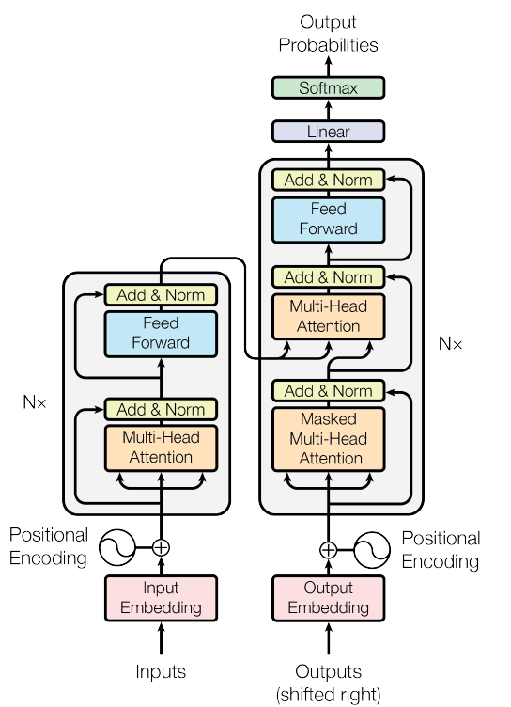

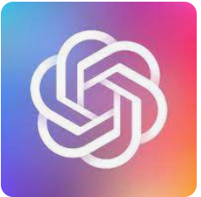

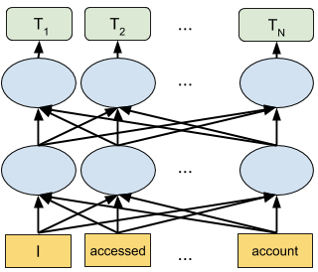
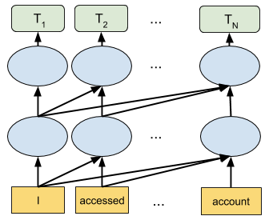
Pre-Trained Language Models
Pre-Trained Language Models (PLM)
Transformer Decoder
Transformer Encoder
BERT
GPT
Bidirectional Encoder Representations from Transformers
Generative Pre-trained Transformer
Notes:
Figure is copied from Google AI Blog
BERT:擅长自然语言理解。
https://www.cs.princeton.edu/courses/archive/spring20/cos598C/lectures/lec4-pretraining.pdf
BERT舍弃了文本生成能力，换来了更强的语义理解能力。E.g., sequence classification and labeling problems
Blog: https://leemeng.tw/attack_on_bert_transfer_learning_in_nlp.html

Slide 5
Pre-Trained Language Models
BERT: Bi-Directional Encoder Representation from Transformers
BERT
GPT
Bidirectional Self-attention Model
Backward-Looking Self-attention Model
Natural Language Understanding
Notes:
Bidirectional encoders overcome this limitation by allowing the self-attention mechanism to range over the entire input.

Slide 6
Pre-Trained Language Models
BERT: Bi-Directional Encoder Representation from Transformers
Bi-Directional Transformer Encoder: Bidirectional encoders use self-attention to map sequences of input embeddings to sequences of output embeddings of the same length, where the output vectors have been contextualized using information from the entire input sequence.
Masked Language Model: To train a bi-directional encoder, instead of predicting the following word, we mask a word in the middle and ask the model to guess the word given the words on both sides.

Slide 7
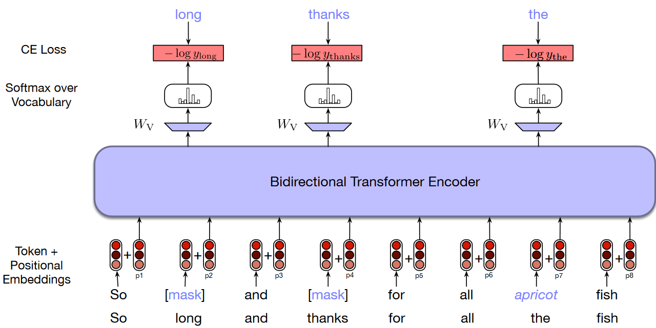
Pre-Trained Language Models
BERT: Masked Language Models
Training Tasks: (1) Fill-in-the-Blank (Cloze)
In BERT, 15% of the input tokens in a training sequence are sampled for learning. Of these, 80% are replaced with [MASK], 10% are replaced with randomly selected tokens, and the remaining 10% are left unchanged.
Learning Word-Level Representation
Notes:
Chapter 11, P6:
Training Bidirectional Encoders
Instead of trying to predict the next word, the model learns to perform a fill-in-the-blank task, technically called the cloze task.
In BERT, 15% of the input tokens in a training sequence are sampled for learning. Of these, 80% are replaced with [MASK], 10% are replaced with randomly selected tokens, and the remaining 10% are left unchanged.
The pre-training procedure largely follows the existing literature on language model pre-training. For the pre-training corpus we use the BooksCorpus (800M words) and English Wikipedia (2,500M words).

Slide 8
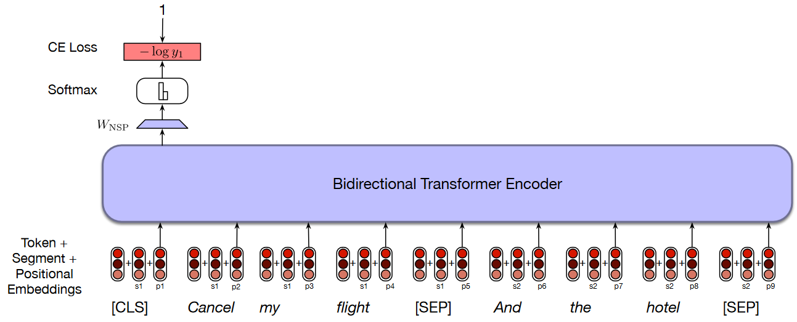
Pre-Trained Language Models
BERT: Masked Language Models
Training Tasks: (2) Next Sentence Prediction (NSP)
Training Data: BooksCorpus + English Wikipedia
Learning Sentence-Level Representation
Notes:
Chapter 11, P9:
Understand sentence relationship
The focus of masked-based learning is on predicting words from surrounding contexts with the goal of producing effective word-level representations. However, an important class of applications involves determining the relationship between pairs of sentences. These includes tasks like paraphrase detection (detecting if two sentences have similar meanings), entailment (detecting if the meanings of two sentences entail or contradict each other) or discourse coherence (deciding if two neighboring sentences form a coherent discourse). To capture the kind of knowledge required for applications such as these, BERT introduced a second learning objective called Next Sentence Prediction (NSP).
The pre-training procedure largely follows the existing literature on language model pre-training. For the pre-training corpus we use the BooksCorpus (800M words) and English Wikipedia (2,500M words).

Slide 9
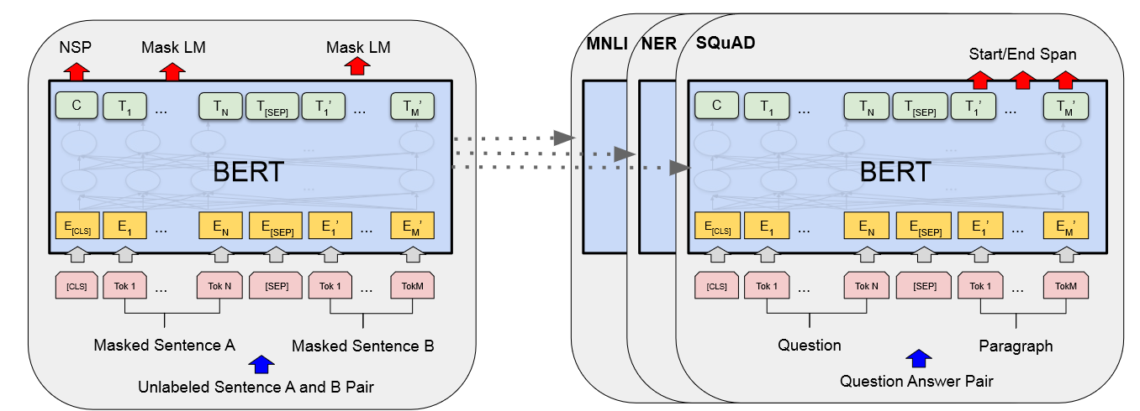
Pre-Trained Language Models
BERT: Masked Language Models
Pre-Training and Fine-Turning
Self-supervised Pre-training
Supervised Fine-Turning
Notes:
Chapter 11, P11:
The power of pre-trained language models lies in their ability to extract generalizations from large amounts of text—generalizations that are useful for myriad downstream applications. To make practical use of these generalizations, we need to create interfaces from these models to downstream applications through a process called fine-tuning. Fine-tuning facilitates the creation of applications on top of pretrained models through the addition of a small set of application-specific parameters.

Slide 10
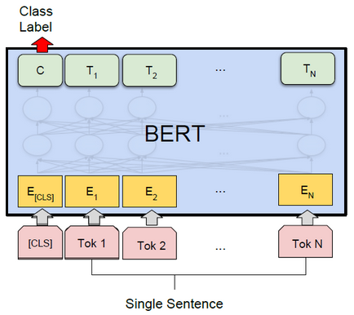
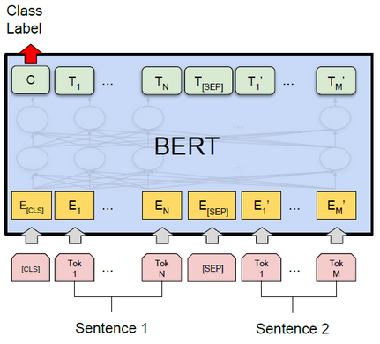
Pre-Trained Language Models
BERT: Masked Language Models
Pre-Training and Fine-Turning
Single Sentence Classification
Sentence Pair Classification

Slide 11
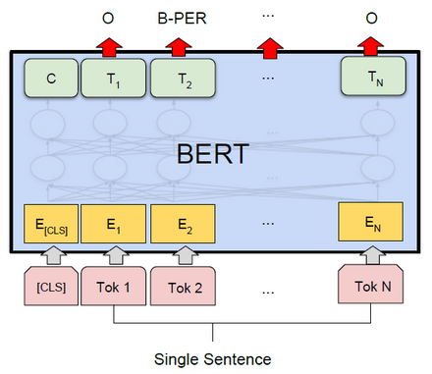
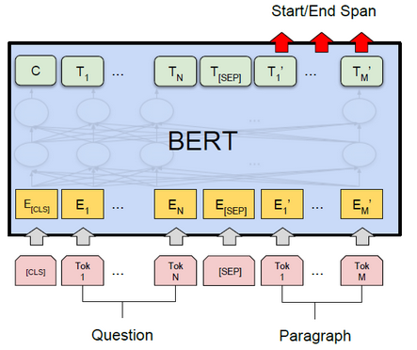
Pre-Trained Language Models
BERT: Masked Language Models
Pre-Training and Fine-Turning
Named Entity Tagging
Answer Extraction
Notes:
Chapter 11, P13:
Sequence Labelling: Sequence labelling tasks, such as part-of-speech tagging or BIO-based named entity recognition, follow the same basic classification approach. Here, the final output vector corresponding to each input token is passed to a classifier that produces a softmax distribution over the possible set of tags.

Slide 12
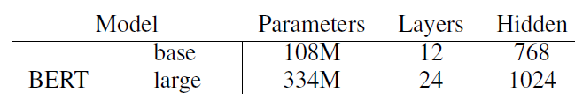
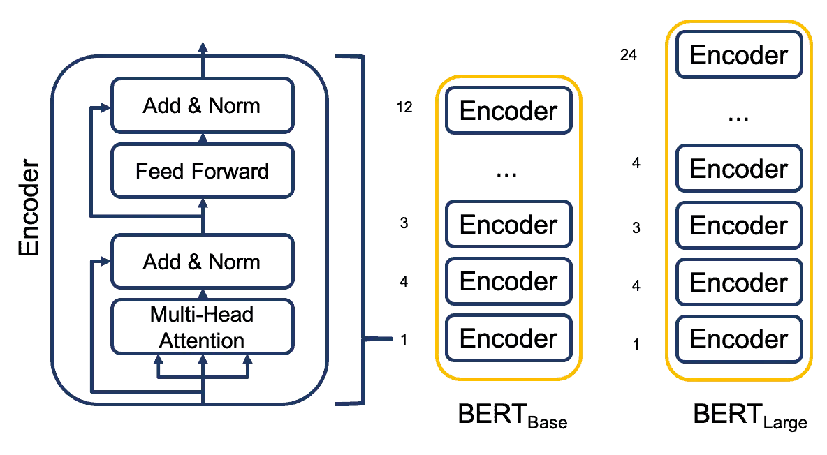
Pre-Trained Language Models
BERT: Masked Language Models
BERT-Base, BERT-Large
Notes:
The result is a model with over 100M parameters.

Slide 13
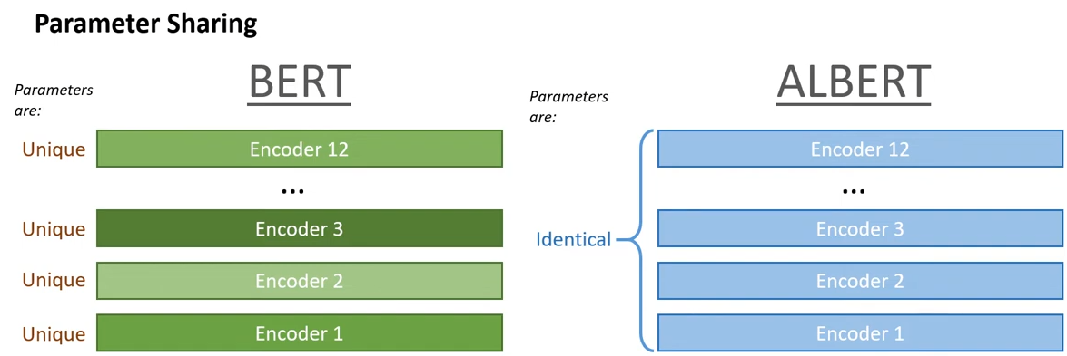
Pre-Trained Language Models
BERT Variations
RoBERTa: BoBERTa: A Robustly Optimized BERT Pre-Training Approach, arXiv’2019.
Employs dynamic masking and remove next sentence prediction.
ALBERT: ALBERT: A Lite BERT for Self-supervised Learning of Language Representations, ICLR’2020.
Proposes parameter reduction techniques.
NSP (Next Sentence Prediction) → SOP (Sentence Order Prediction)
Notes:
RoBERTa leverages with dynamic masking (preprocess vs. training), remove NSP. BERT base has 9x more parameters than the ALBERT base.
ALBERT: In addition to the masked language modeling (MLM) loss, BERT uses an additional loss called next-sentence prediction (NSP) where NSP is a binary classification loss for predicting whether two segments appear consecutively in the original text. However, subsequent studies found that NSP’s impact unreliable and decided to eliminate it. It is conjectured that the main reason behind NSP’s ineffectiveness is its lack of difficulty as a task, as compared to MLM. ALBERT maintains that inter-sentence modeling is an important aspect of language understanding, but a loss based primarily on coherence is proposed. That is, for ALBERT, a sentence-order prediction (SOP) loss is used, which avoids topic prediction and instead focuses on modeling inter-sentence coherence.
SpanBERT is an improvement on the BERT model providing improved prediction of spans of text. ... It differs from BERT model in its masking scheme as BERT used to randomly mask tokens in a sequence but here in SpanBERT, we mask random contiguous spans of text. Another difference is that of the training objective. ii) training the model based on tokens at the start and end of the boundary of span (known as Span Boundary Objective) to predict the entire marked spans. We present SpanBERT, a pre-training method that is designed to better represent and predict spans of text. Our approach extends BERT by (1) masking contiguous random spans, rather than random tokens, and (2) training the span boundary representations to predict the entire content of the masked span, without relying on the individual token representations within it. SpanBERT consistently outperforms BERT and our better-tuned baselines, with substantial gains on span selection tasks such as question answering and coreference resolution.

Slide 14
Pre-Trained Language Models
BERT Variations
SpanBERT: Improving Pre-training by Representing and Predicting Spans, TACL’2020.
Masks random contiguous spans, rather than random individual tokens.
Trains the model based on tokens at the start and end of the boundary of span to predict the entire marked spans.
Notes:
SpanBERT is an improvement on the BERT model providing improved prediction of spans of text. ... It differs from BERT model in its masking scheme as BERT used to randomly mask tokens in a sequence but here in SpanBERT, we mask random contiguous spans of text. Another difference is that of the training objective. ii) training the model based on tokens at the start and end of the boundary of span (known as Span Boundary Objective) to predict the entire marked spans. We present SpanBERT, a pre-training method that is designed to better represent and predict spans of text. Our approach extends BERT by (1) masking contiguous random spans, rather than random tokens, and (2) training the span boundary representations to predict the entire content of the masked span, without relying on the individual token representations within it. SpanBERT consistently outperforms BERT and our better-tuned baselines, with substantial gains on span selection tasks such as question answering and coreference resolution.

Slide 15
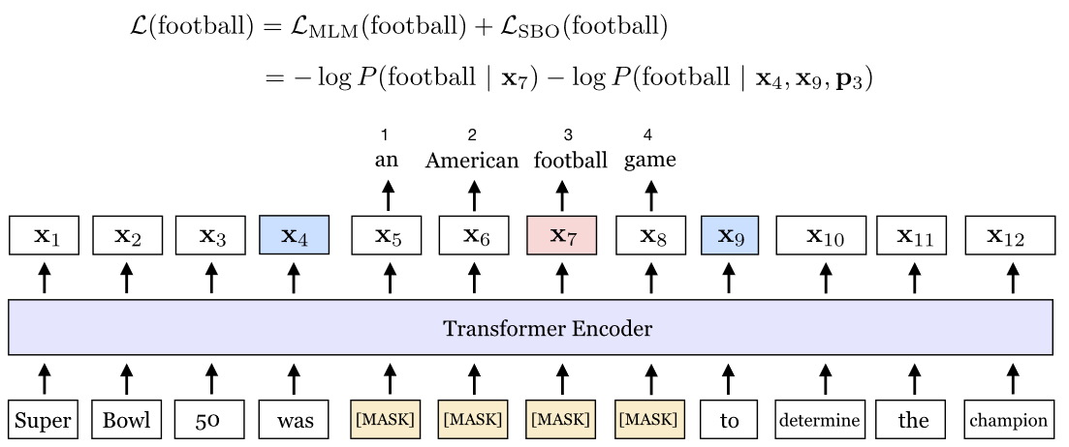
Pre-Trained Language Models
The span an American football game is masked. The Span-Boundary Objective (SBO) uses the output representations of the boundary tokens, x4 and x9 (in blue), to predict each token in the masked span. The equation shows the MLM and SBO loss terms for predicting the token, football (in pink), which as marked by the position embedding p3, is the third token from x4.

Slide 16
Pre-Trained Language Models
Homework
Both RNN and BERT are effective for sequence labeling tasks like Part-of-Speech Tagging and Name Entity Recognition. (1) Can these models also be applied to Chinese word segmentation? If yes, how should we prepare the training data, including label annotation, and how can we train the RNN and BERT models for this task? (2) In addition, are there traditional non-neural-network sequence models that are suitable for Chinese word segmentation? If so, what are they and what features would you like to consider as input? (3) Furthermore, is it possible to use an encoder-decoder model for Chinese word segmentation? If so, how can this be achieved? If you answer to the above questions are no, please explain why.

Slide 17
Pre-Trained Language Models
GPT: Auto-Regressive Language Models
BERT
GPT
Bidirectional Self-attention Model
Backward-Looking Self-attention Model
Natural Language Generation
Notes:
Bidirectional encoders overcome this limitation by allowing the self-attention mechanism to range over the entire input.

Slide 18
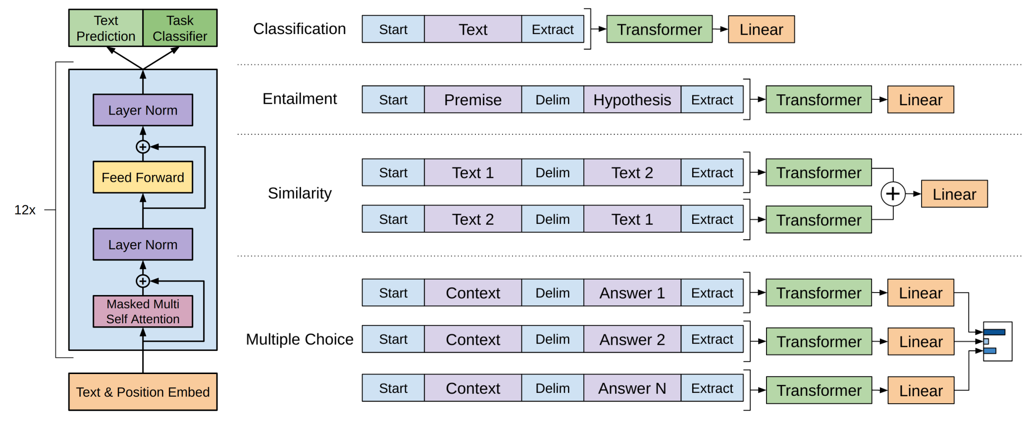
Pre-Trained Language Models
Self-Supervised Pre-Training
Supervised
Fine-Turning
Pre-Trained
Task-Specific Learning
Softmax
Special Start Token
Special Delimiter Token
Special End Token
Notes:
https://adimen.si.ehu.es/~rigau/teaching/EHU/TAIA/Curs2020-2021/Homework1/G2Report.pdf
How to adapt a single architecture to multiple input formats?
https://www.cs.princeton.edu/courses/archive/spring20/cos598C/lectures/lec4-pretraining.pdf
Textual entailment For entailment tasks, we concatenate the premise p and hypothesis h token sequences, with a delimiter token ($) in between.
Similarity For similarity tasks, there is no inherent ordering of the two sentences being compared. To reflect this, we modify the input sequence to contain both possible sentence orderings (with a delimiter in between) and process each independently to produce two sequence representations h m l which are added element-wise before being fed into the linear output layer.
Question Answering and Commonsense Reasoning For these tasks, we are given a context document z, a question q, and a set of possible answers {ak}. We concatenate the document context and question with each possible answer, adding a delimiter token in between to get [z; q; $; ak]. Each of these sequences are processed independently with our model and then normalized via a softmax layer to produce an output distribution over possible answers.

Slide 19
Pre-Trained Language Models
GPT: Auto-Regressive Language Models
Training Task: Next Word Prediction
Task Adaptation
Utilizes Task-Specific Input Adaptation
Trains Parameters of an Added Linear Output Layer
It is found that including language modeling as an auxiliary objective to the fine-tuning helps learning (fine-tuning as continuous pretraining).
Training Data: BooksCorpus
Notes:
https://medium.com/walmartglobaltech/the-journey-of-open-ai-gpt-models-32d95b7b7fb2
Paper:
We use a multi-layer Transformer decoder [34] for the language model, which is a variant of the transformer. This model applies a multi-headed self-attention operation over the input context tokens followed by position-wise feedforward layers to produce an output distribution over target tokens.
Pretraining on large amounts of data via the self-supervised language model objective turns out to be a very useful way of incorporating rich information about language, and the resulting representations make it much easier to learn from the generally smaller supervised datasets for tagging or sentiment.
We use the BooksCorpus dataset for training the language model. It contains over 7,000 unique unpublished books.
Our experiments also use an auxiliary objective, but as we show, unsupervised pre-training
already learns several linguistic aspects relevant to target tasks.
GPT擅长自然语言生成任务。Such summarization, machine translation, response generation, etc.
预训练/适应模式（Pre-Training/Adaption）：在大量数据上预训练一个语言模型并使其适应多个下游应用任务。斯坦福大学学者称之为基础模型。
Different from traditional supervised learning, PLMs based on self-supervised learning are usually pre-trained on general-purpose large-scale unlabeled data first and then fine-tuned on small-scale labeled data for the specific tasks.
Chapter 11, P1:
The bulk of this knowledge acquisition happens as a by-product of reading. Research into the average amount of time children spend reading, and the lexical diversity of the texts they read, indicate that it is possible to achieve the desired rate.
Chapter 11, P2:
We call pretraining the process of learning some sort of representation of meaning for words or sentences by processing very large amounts of text. We’ll call these pretrained models pretrained language models, since they can take the form of the transformer language models we introduced in Chapter 9. We call fine-tuning the process of taking the representations from these pretrained models, and further training the model, often via an added neural net classifier, to perform some downstream task like named entity tagging or question answering or coreference. The intuition is that the pretraining phase learns a language model that instantiates a rich representations of word meaning, that thus enables the model to more easily learn (‘be fine-tuned to’) the requirements of a downstream language understanding task.

Slide 20
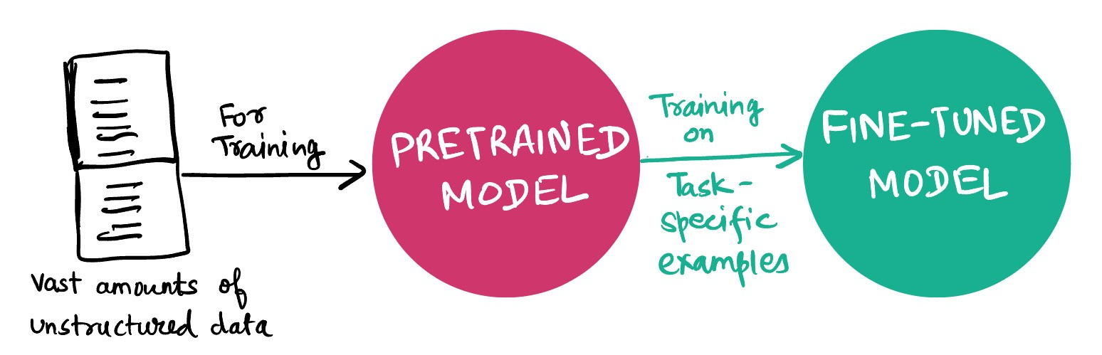
Pre-Trained Language Models
Pre-Training and Fine-Tuning Paradigm
Pre-trained language models are independent of any particular task.
Task-Specific Model 1
Pre-train
Fine-Tune
Task-Specific Model 2
Text without Annotation
general-purpose large-scale unlabeled data
Task-Specific Data
with Annotation
Task-Specific Model 3
Notes:
https://medium.com/walmartglobaltech/the-journey-of-open-ai-gpt-models-32d95b7b7fb2
Paper:
We use a multi-layer Transformer decoder [34] for the language model, which is a variant of the transformer [62]. This model applies a multi-headed self-attention operation over the input context tokens followed by position-wise feedforward layers to produce an output distribution over target tokens.
Pretraining on large amounts of data via the self-supervised language model objective turns out to be a very useful way of incorporating rich information about language, and the resulting representations make it much easier to learn from the generally smaller supervised datasets for tagging or sentiment.
We use the BooksCorpus dataset for training the language model. It contains over 7,000 unique unpublished books.
GPT擅长自然语言生成任务。Such summarization, machine translation, response generation, etc.

Slide 21
Pre-Trained Language Models
Pre-Training and Fine-Tuning Paradigm
Un-Supervised Pre-Training and Supervised Fine-Turning
Pre-training is the process of learning some sort of representation of meaning for words or sentences by processing very large amounts of (raw) text.
Fine-tuning is the process of taking the representations from a pre-trained model and further training the model on task-specific data to perform a downstream task, like text classification or sequence labeling, using task-specific optimizations.
Notes:
Chapter 11, P1:
The bulk of this knowledge acquisition happens as a by-product of reading. Research into the average amount of time children spend reading, and the lexical diversity of the texts they read, indicate that it is possible to achieve the desired rate.
Chapter 11, P2:
We call pretraining the process of learning some sort of representation of meaning for words or sentences by processing very large amounts of text. We’ll call these pretrained models pretrained language models, since they can take the form of the transformer language models we introduced in Chapter 9. We call fine-tuning the process of taking the representations from these pretrained models, and further training the model, often via an added neural net classifier, to perform some downstream task like named entity tagging or question answering or coreference. The intuition is that the pretraining phase learns a language model that instantiates a rich representations of word meaning, that thus enables the model to more easily learn (‘be fine-tuned to’) the requirements of a downstream language understanding task.

Slide 22
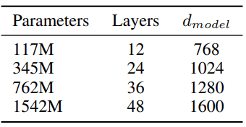
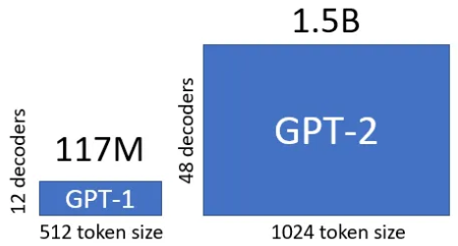
Pre-Trained Language Models
GPT-2: Auto-Regressive Language Models
Training Data: WebText
The GPT-2 model largely follows the details of GPT-1 with a few modifications.
GPT-2 is 10 times more than GPT-1.
Notes:
GPT-1: We designed a series of heuristic solutions that use the underlying generative model to perform tasks without supervised finetuning.
GPT-2 small=GPT-1, GPT-2 is 10 times more than GPT-1.
GPT-2: GPT-2 aimed at learning multiple tasks using the same unsupervised model. To achieve that, the learning objective should be modified to P(output|input, task). This modification is known as task conditioning, where the model is expected to produce different output for same input for different tasks. In stead of rearranging the sequence, as was done for GPT-1 for fine-turning, input to GPT-2 was given in a format which expected the model to understand the nature of task and provide answers.

Slide 23

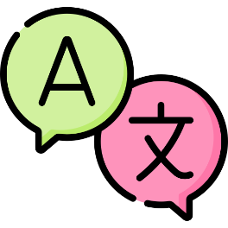

Pre-Trained Language Models
GPT-2: Auto-Regressive Language Models
Un-supervised Multi-Task Learning: One Unsupervised Model for Multi-Tasks (Remove Task-Specific Fine-Tuning)
Fine-Tuning
Task-1
GPT
GPT
Fine-
Tuning
Task-2
GPT
GPT-2
Fine-Tuning
Task-3
GPT
Without any Parameter or
Architecture Modification
GPT-2 aims at learning multiple tasks using the same unsupervised model (by designing a series of heuristic solutions).
Notes:
Our suspicion is that the prevalence of single task training on single domain datasets is a major contributor to the lack of generalization observed in current systems.
Our largest model, GPT-2, is a 1.5B parameter Transformer that achieves state of the art results on 7 out of 8 tested language modeling datasets in a zero-shot setting but still underfits WebText. …… We would like to move towards more general systems which can perform many tasks – eventually without the need to manually create and label a training dataset for each one. …. We demonstrate language models can perform down-stream tasks in a zero-shot setting – without any parameter or architecture modification. We demonstrate this approach shows potential by highlighting the ability of language models to perform a wide range of tasks in a zero-shot setting.
GPT-2: GPT-2 aimed at learning multiple tasks using the same unsupervised model. To achieve that, the learning objective should be modified to P(output|input, task). This modification is known as task conditioning, where the model is expected to produce different output for same input for different tasks. In stead of rearranging the sequence, as was done for GPT-1 for fine-turning, input to GPT-2 was given in a format which expected the model to understand the nature of task and provide answers.

Slide 24
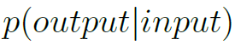
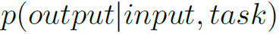
Pre-Trained Language Models
GPT-2: Auto-Regressive Language Model
Multi-Task Learning
Trains a single model to perform many different tasks, even for the same input, by conditioning not only on the input but also on the task to be performed.
For example, a translation training example can be written as the sequence (English text, translate to French, French text), and a reading comprehension training example can be written as (document, question, answer the question, answer).
Notes:
Our suspicion is that the prevalence of single task training on single domain datasets is a major contributor to the lack of generalization observed in current systems.
Our largest model, GPT-2, is a 1.5B parameter Transformer that achieves state of the art results on 7 out of 8 tested language modeling datasets in a zero-shot setting but still underfits WebText. …… We would like to move towards more general systems which can perform many tasks – eventually without the need to manually create and label a training dataset for each one. …. We demonstrate language models can perform down-stream tasks in a zero-shot setting – without any parameter or architecture modification. We demonstrate this approach shows potential by highlighting the ability of language models to perform a wide range of tasks in a zero-shot setting.
GPT-2: GPT-2 aimed at learning multiple tasks using the same unsupervised model. To achieve that, the learning objective should be modified to P(output|input, task). This modification is known as task conditioning, where the model is expected to produce different output for same input for different tasks. In stead of rearranging the sequence, as was done for GPT-1 for fine-turning, input to GPT-2 was given in a format which expected the model to understand the nature of task and provide answers.

Slide 25
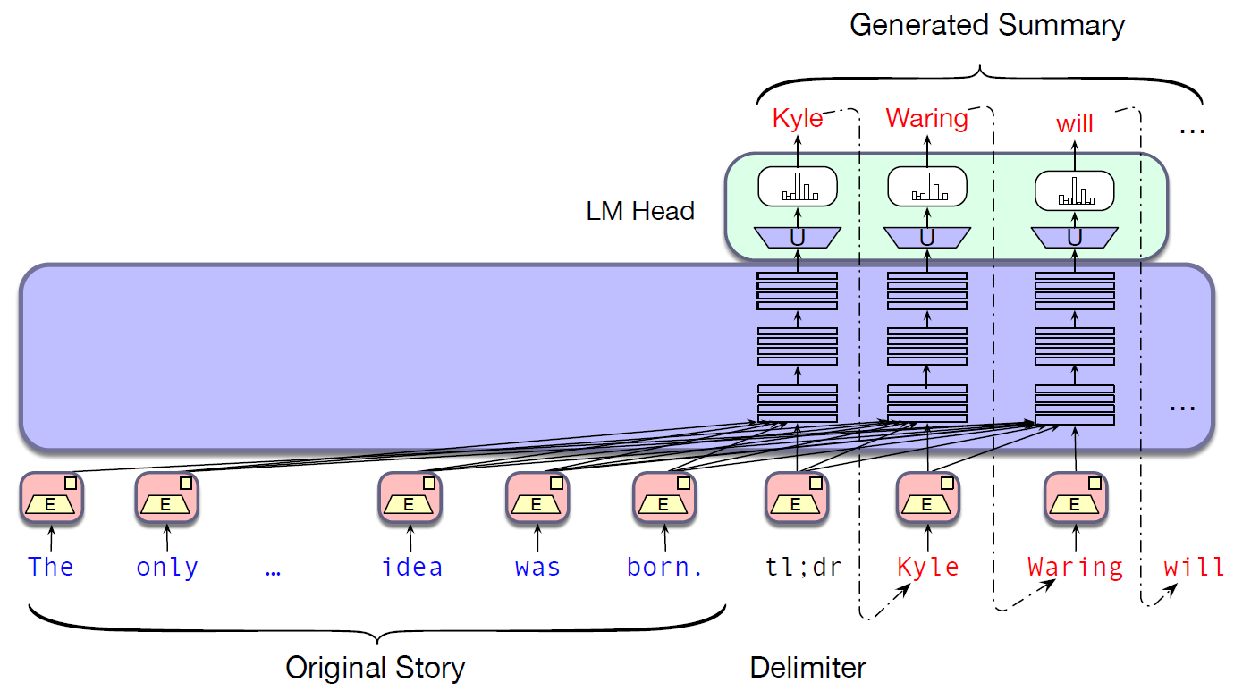
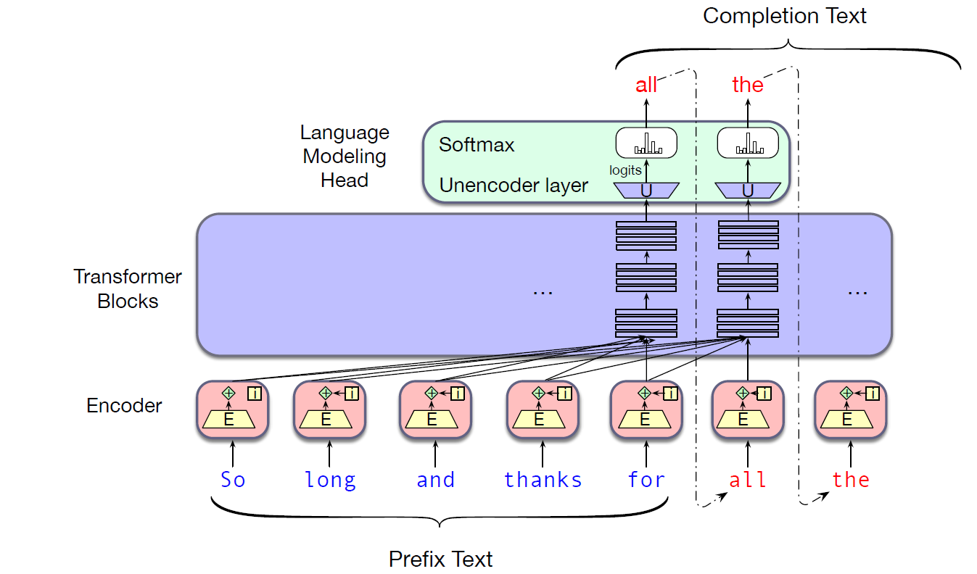
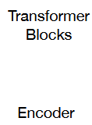
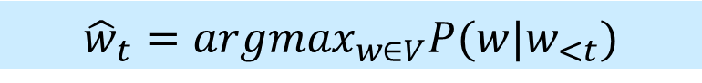
Pre-Trained Language Models
Conditional generation is the task of generating text conditioned on an input piece of text.
Generated Answer
Charles .
Q: Who wrote the book “The Origin of Species”? A:
Charles .
$${\hat{w}}_{t}={argmax}_{w∈V}P(w|w_{<t})$$

Slide 26
Pre-Trained Language Models
GPT-2: Auto-Regressive Language Models
Zero-Shot NLP Task Generalization: Reading Comprehension, Summarization, Translation, and Question Answering
Reading Comprehension
Conditioned on a document, the history of the associated conversation and a final token A:, GPT-2 achieves 55 F1, comparable to 3 out of 4 supervised baseline systems. The supervised SOTA, a BERT based system is nearing the 89 F1 performance of humans.
Summarization
Generate 3 sentences conditioned on a document and TL;DR:. GPT-2 often focuses on recent content from the article or confuses specific details and just barely outperforms selecting 3 random sentences.
Notes:
Reading Comprehension:
The Conversation Question Answering dataset (CoQA) Reddy et al. (2018) consists of documents from 7 different domains paired with natural language dialogues between a question asker and a question answerer about the document. CoQA tests reading comprehension capabilities and also the ability of models to answer questions that depend on conversation history (such as “Why?”). Greedy decoding from GPT-2 when conditioned on a document, the history of the associated conversation, and a final token A: achieves 55 F1 on the development set. This matches or exceeds the performance of 3 out of 4 baseline systems without using the 127,000+ manually collected question answer pairs those baselines were trained on. The supervised SOTA, a BERT based system is nearing the 89 F1 performance of humans.
Summarization:
To induce summarization behavior we add the text TL;DR: () after the article and generate 100 tokens with Top-k random sampling. We use the first 3 generated sentences in these 100 tokens as the summary. While qualitatively the generations resemble summaries, they often focus on recent content from the article or confuse specific details such as how many cars were involved in a crash or whether a logo was on a hat or shirt. On the commonly reported ROUGE 1,2,L metrics the generated summaries only begin to approach the performance of classic neural baselines and just barely outperforms selecting 3 random sentences from the article.

Slide 27
Pre-Trained Language Models
GPT-2: Auto-Regressive Language Models
Translation
GPT-2 is conditioned on a context of example pairs of the format “English sentence = French sentence”. And then, after a final prompt of “English sentence =”, the translation is generated. GPT-2 gets 5 BLEU, slightly worse than a word-by-word substitution with a bilingual lexicon and much worse than the 33.5 BLEU of the current best unsupervised machine translation approach.
Question Answering
Similar to translation, the context of the language model is seeded with example question answer pairs. GPT-2 answers 4.1% of questions correctly, much, much, worse than the 30 to 50% range of open domain question answering systems. It also suggests that model capacity has been a major factor in the poor performance of neural systems on this kind of task.
Notes:
Translation: (with examples)
In order to help it infer that this is the desired task, we condition the language model on a context of example pairs of the format English sentence = french sentence and then after a final prompt of English sentence = we sample from the model with greedy decoding and use the first generated sentence as the translation. On the WMT-14 English-French test set, GPT-2 gets 5 BLEU, which is slightly worse than a word-by-word substitution with a bilingual lexicon inferred in previous work on unsupervised word translation. On the WMT-14 French-Englishtest set, GPT-2 is able to leverage its very strong English language model to perform significantly better, achieving 11.5 BLEU. This outperforms several unsupervised machine translation baselines from x and y, but is still much worse than the 33.5 BLEU of the current best unsupervised machine translation approach. Performance on this task was surprising to us, since we deliberately removed non-English webpages from WebText as a filtering step. In order to confirm this, we ran a byte-level language detector2 onWebText which detected only 10MB of data in the French language which is approximately 500x smaller than the monolingual French corpus common in prior unsupervised machine translation research.
Question Answering: (with examples)
A potential way to test what information is contained within a language model is to evaluate how often it generates the correct answer to factoid-style questions. Previous showcasing of this behavior in neural systems where all information is stored in parameters. Similar to translation, the context of the language model is seeded with example question answer pairs which helps the model infer the short answer style of the dataset. GPT-2 answers 4.1% of questions correctly when evaluated by the exact match metric commonly used on reading comprehension datasets like SQUAD. As a comparison point, the smallest model does not exceed the 1.0% accuracy of an incredibly simple baseline which returns the most common answer for each question type (who, what, where, etc...). GPT-2 answers 5.3 times more questions correctly, suggesting that model capacity has been a major factor in the poor performance of neural systems on this kind of task as of yet. The performance of GPT-2 is still much, much, worse than the 30 to 50% range of open domain question answering systems which hybridize information retrieval with extractive document question answering.

Slide 28
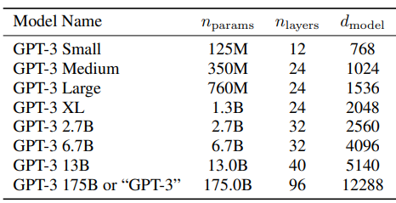
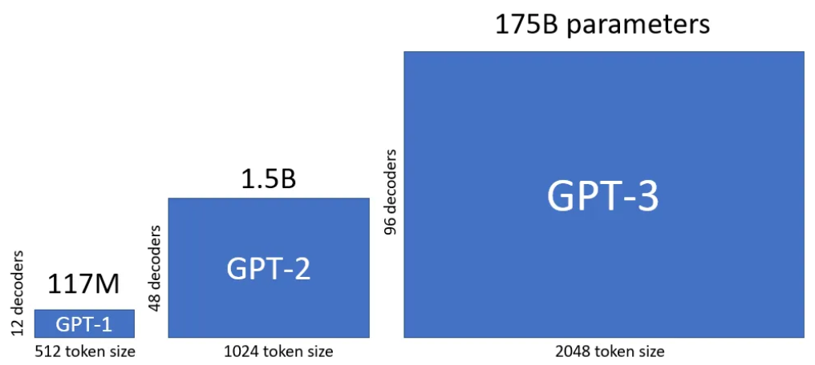
Pre-Trained Language Models
GPT-3: Auto-Regressive Language Models
The GPT-3 architecture is mostly the same as GPT-2 one.
The largest GPT-3 model size is 100 times larger than the largest GPT-2 model.
GPT-3 achieves strong performance on many NLP datasets, including translation, question-answering, and cloze tasks, as well as several tasks that require on-the-fly reasoning or domain adaptation.
Notes:
The GPT-3 architecture is mostly the same as GPT-2 one (there are minor differences, see below).
The largest GPT-3 model size is 100x larger than the largest GPT-2 model (175B vs. 1.5B parameters).
Do not use fine turning
Condition the model with the task description and/or some demonstrations of task.
GPT-3 achieves strong performance on many NLP datasets, including translation, question-answering, and cloze tasks, as well as several tasks that require on-the-fly reasoning or domain adaptation, such as unscrambling words, using a novel word in a sentence, or performing 3-digit arithmetic.

Slide 29
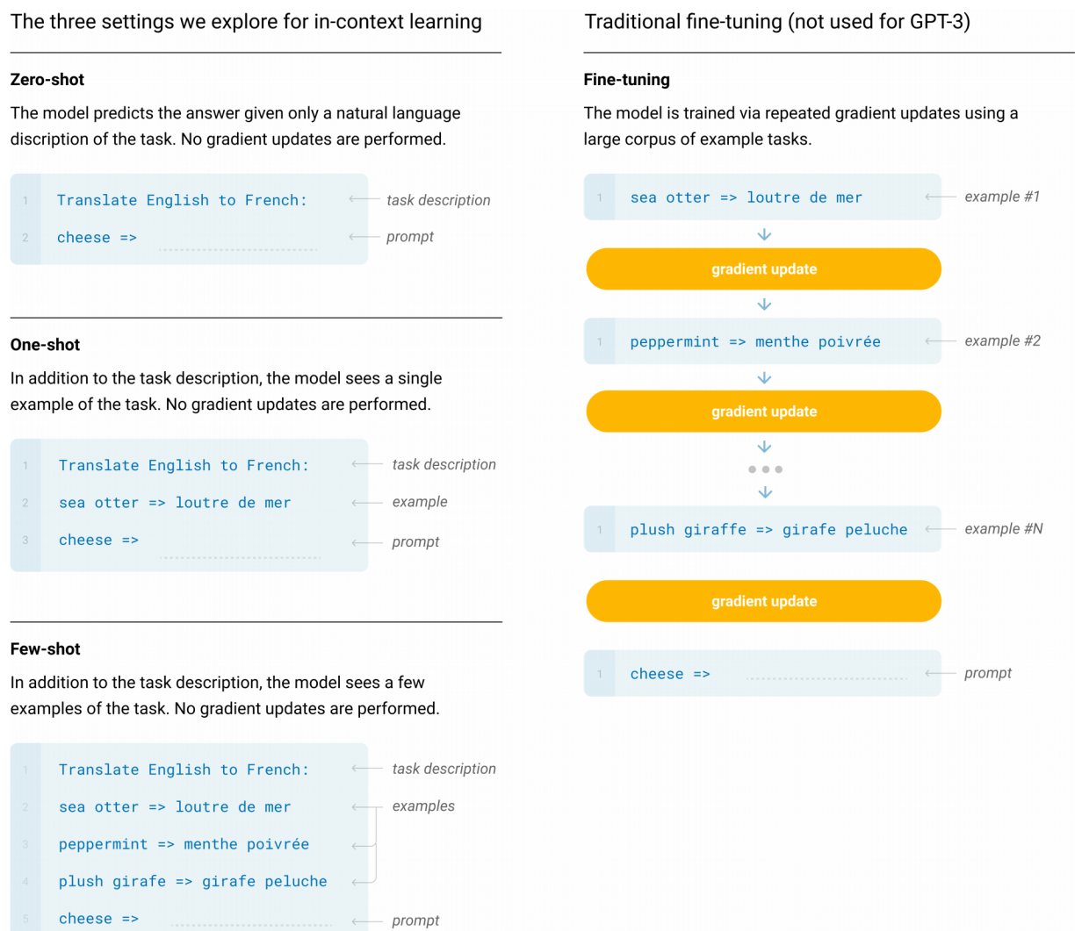
Learning within the Context
Demonstrations of Task
Notes:
Do not use fine turning
Condition the model with the task description and/or some demonstrations of task.
Few-Shot (FS) is the term we will use in this work to refer to the setting where the model is given a few demonstrations of the task at inference time as conditioning , but no weight updates are allowed.
One-Shot (1S) is the same as few-shot except that only one demonstration is allowed, in addition to a natural language description of the task.
Zero-Shot (0S) is the same as one-shot except that no demonstrations are allowed, and the model is only given a natural language instruction describing the task.

Slide 30
Pre-Trained Language Models
GPT-3: Auto-Regressive Language Models
Prompt-based, In-Context Learning (ICL): Text Interaction with the Model, without any Gradient Updates or Fine-Tuning
Zero-Shot, One-Shot and Few-Shot Learning
Conclusion: Larger models make increasingly efficient use of in-context information.
In-context learning (ICL) is a specific method of prompt engineering where demonstrations of the task are provided to the model as part of the prompt (in natural language). With ICL, you can use off-the-shelf large language models (LLMs) to solve novel tasks without the need for fine-tuning.
Notes:
The GPT-3 architecture is mostly the same as GPT-2 one (there are minor differences, see below).
The largest GPT-3 model size is 100x larger than the largest GPT-2 model (175B vs. 1.5B parameters).
Do not use fine turning
Condition the model with the task description and/or some demonstrations of task.
GPT-3 achieves strong performance on many NLP datasets, including translation, question-answering, and cloze tasks, as well as several tasks that require on-the-fly reasoning or domain adaptation, such as unscrambling words, using a novel word in a sentence, or performing 3-digit arithmetic.

Slide 31
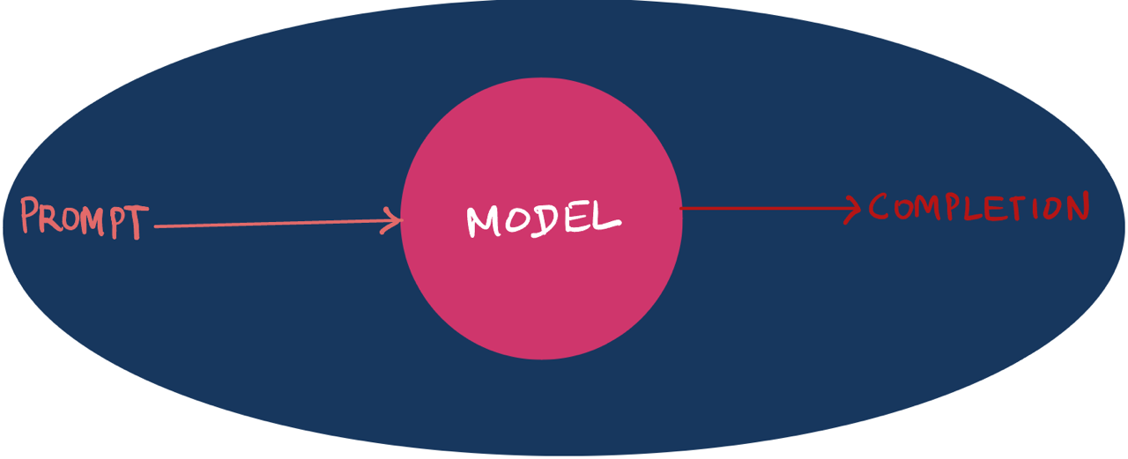
Pre-Trained Language Models
GPT-3: Auto-Regressive Language Models
Prompt
Completion

Slide 32
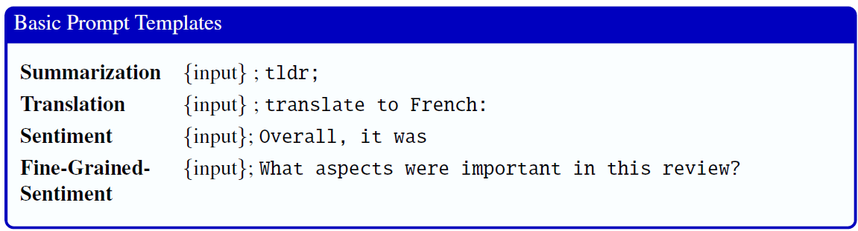
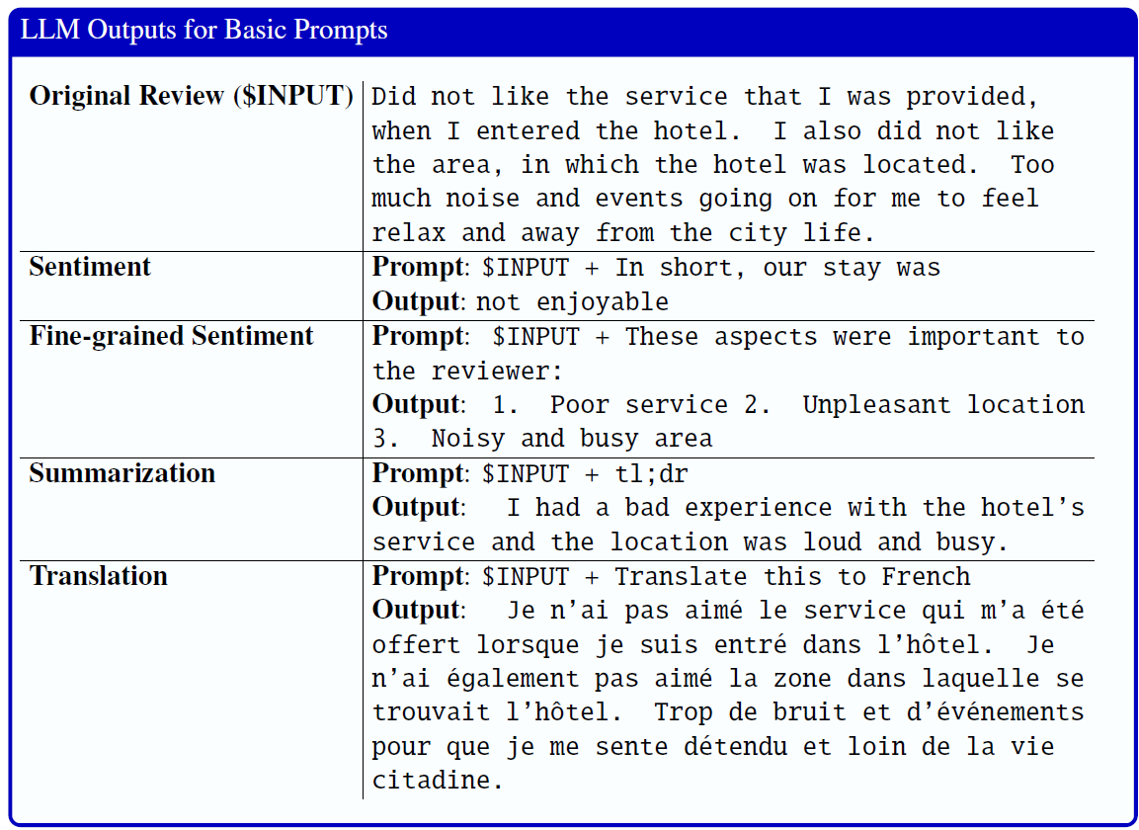

Slide 33
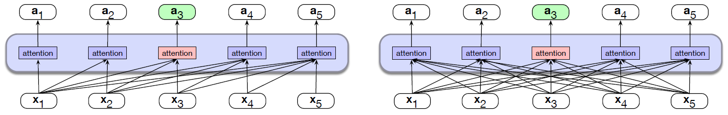
Pre-Trained Language Models
GPT vs. BERT: A Comparison
Decoder-only Model
Uni-Directional Attention: Left Context Only
Causal Language Model: Autoregressive Text Generation
Encoder-only Model
Bi-Directional Attention, Left and Right Context
Masked Language Model: Language Understanding, Contextual Embedding
Notes:
Chapter 11, P9:
Understand sentence relationship
The focus of masked-based learning is on predicting words from surrounding contexts with the goal of producing effective word-level representations. However, an important class of applications involves determining the relationship between pairs of sentences. These includes tasks like paraphrase detection (detecting if two sentences have similar meanings), entailment (detecting if the meanings of two sentences entail or contradict each other) or discourse coherence (deciding if two neighboring sentences form a coherent discourse). To capture the kind of knowledge required for applications such as these, BERT introduced a second learning objective called Next Sentence Prediction (NSP).

Slide 34

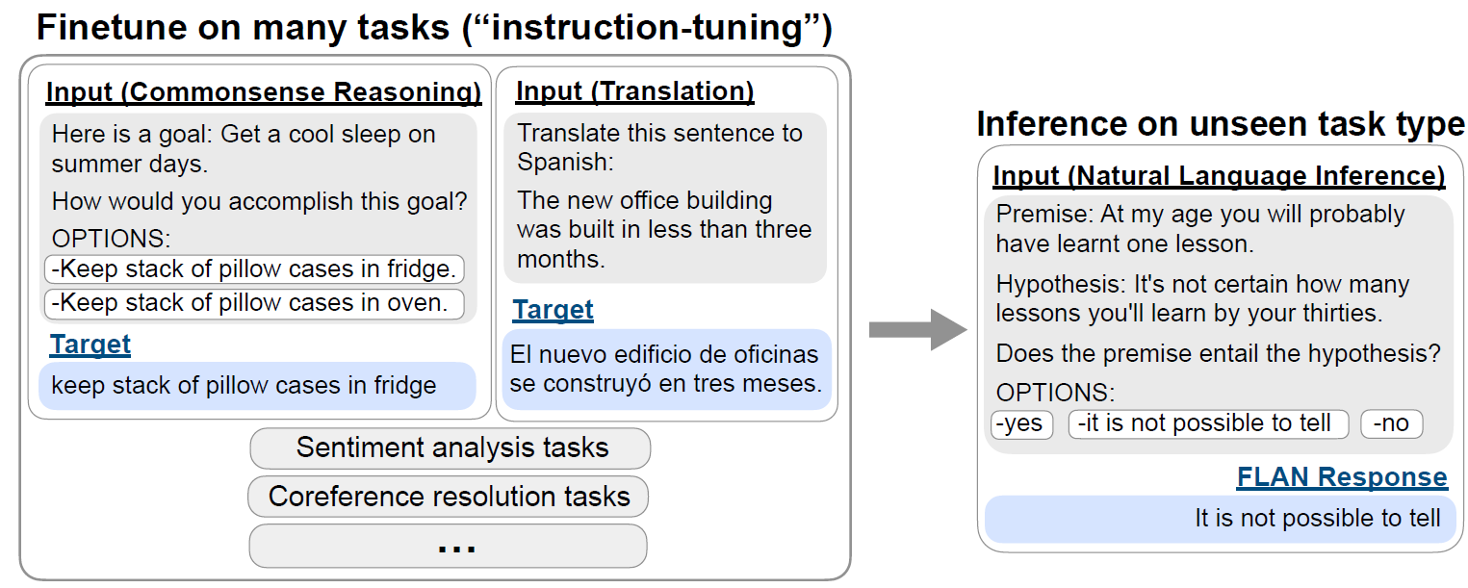
Pre-Trained Language Models
Instruction Tuning
FLAN (Finetuned Language Net) is a decoder-only transformer language model of 137B parameters
Notes:
Instruction Tuning for Large Language Models: A Survey
Instruction Tuning｜谷歌Quoc V.Le团队提出又一精调范式 Rumor: https://zhuanlan.zhihu.com/p/408166011
Finetuned Language Models Are Zero-Shot Learners

Slide 35
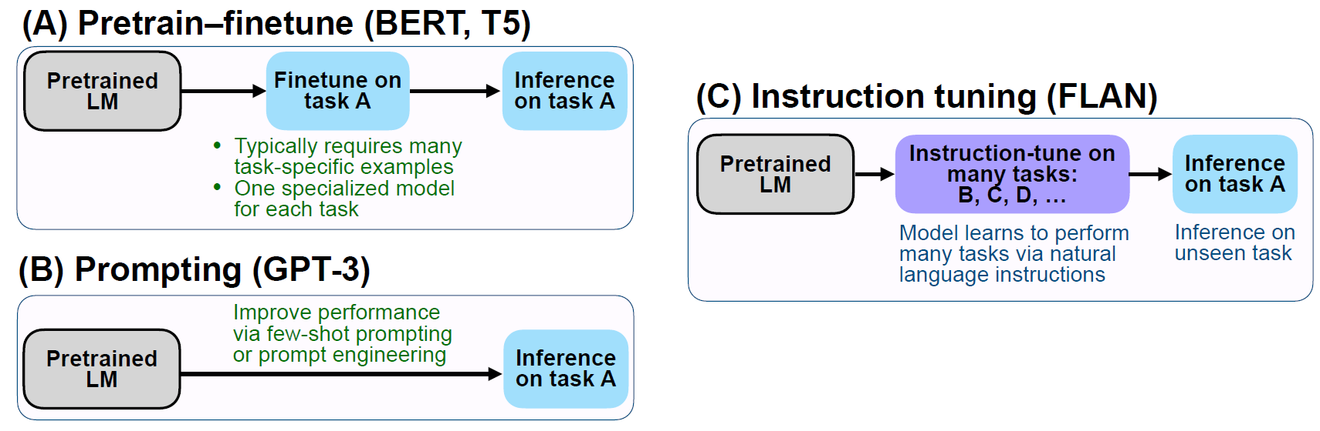
Pre-Trained Language Models
Instruction Tuning
Instruction tuning combines appealing aspects of both the pretrain/finetune and prompting paradigms by using supervision via finetuning. The empirical results demonstrate promising abilities of language models to perform tasks described purely via instructions.
Comparing Instruction Tuning with
Pretrain/Finetune and Prompting
Notes:
Finetuned Language Models Are Zero-Shot Learners, ICLR’2021.
Instruction tuning is a simple method that, as depicted in Figure, combines appealing aspects of both the pretrain–finetune and prompting paradigms by using supervision via finetuning to improve language model’s responses to inference-time text interactions. The empirical results demonstrate promising abilities of language models to perform tasks described purely via instructions.

Slide 36
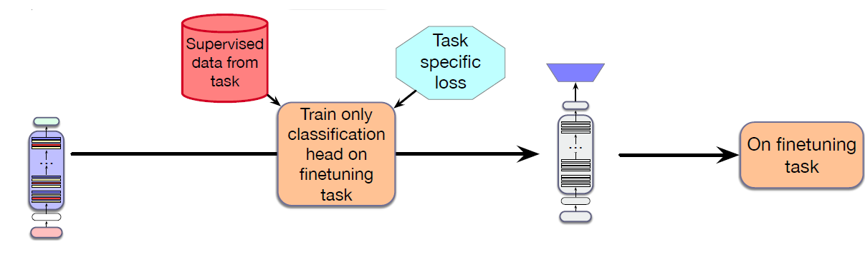
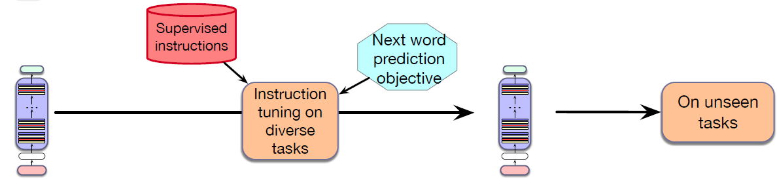
Pre-Trained Language Models
Task-based Fine-Tuning
Instruction Tuning
Notes:
How does instruction tuning differ from the other kinds of finetuning?
In the first example, introduced in, Chapter 10 we can finetune as a way of adapting to a new domain by just continuing pretraining the LLM on data from a new domain. In this method all the parameters of the LLM are updated.
In the task-based finetuning of Chapter 11, we adapt to a particular task by adding a new specialized classification head and updating its features via its own loss function (e.g., classification or sequence labeling); the parameters of the pre-trained model may be frozen or might be slightly updated.
Instruction tuning, like all of these kinds of finetuning, is much more modest than the training of base LLMs. Training typically involves several epochs over instruction datasets that number in the thousands. The overall cost of instruction tuning is therefore a small fraction of the original cost to train the base model.

Slide 37
Pre-Trained Language Models
Instruction Tuning
Instruction tuning (short for instruction finetuning, and sometimes even short-ended to instruct tuning) is a method for making an LLM better at following instructions. It involves taking a base pretrained LLM and continue training it to follow instructions for a range of tasks, by finetuning it on a corpus of instructions and responses, by using the same language modeling objective used to train the original model.
The resulting model not only learns those tasks, but also engages in a form of meta-learning, i.e., it improves its ability to follow instructions generally.

Slide 38
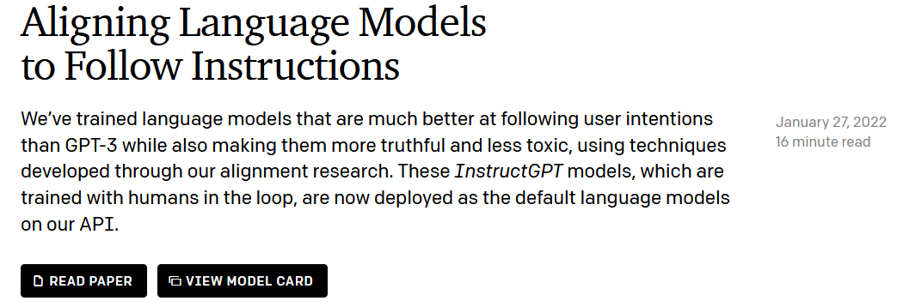
Pre-Trained Language Models
InstructGPT: Trained with Humans in the Loop
Instruction Tuning (aka. Instruction Finetuning and Instruct Tuning)
Model Alignment: Align language models to follow instructions.
Reinforcement Learning from Human Feedback (RLHF) or DPO
Notes:
https://openai.com/blog/instruction-following/
We’ve trained language models that are much better at following user intentions than GPT-3 while also making them more truthful and less toxic, using techniques developed through our alignment research. These InstructGPT models, which are trained with humans in the loop, are now deployed as the default language models on our API.
InstructGPT is better than GPT-3 at following English instructions.

Slide 39
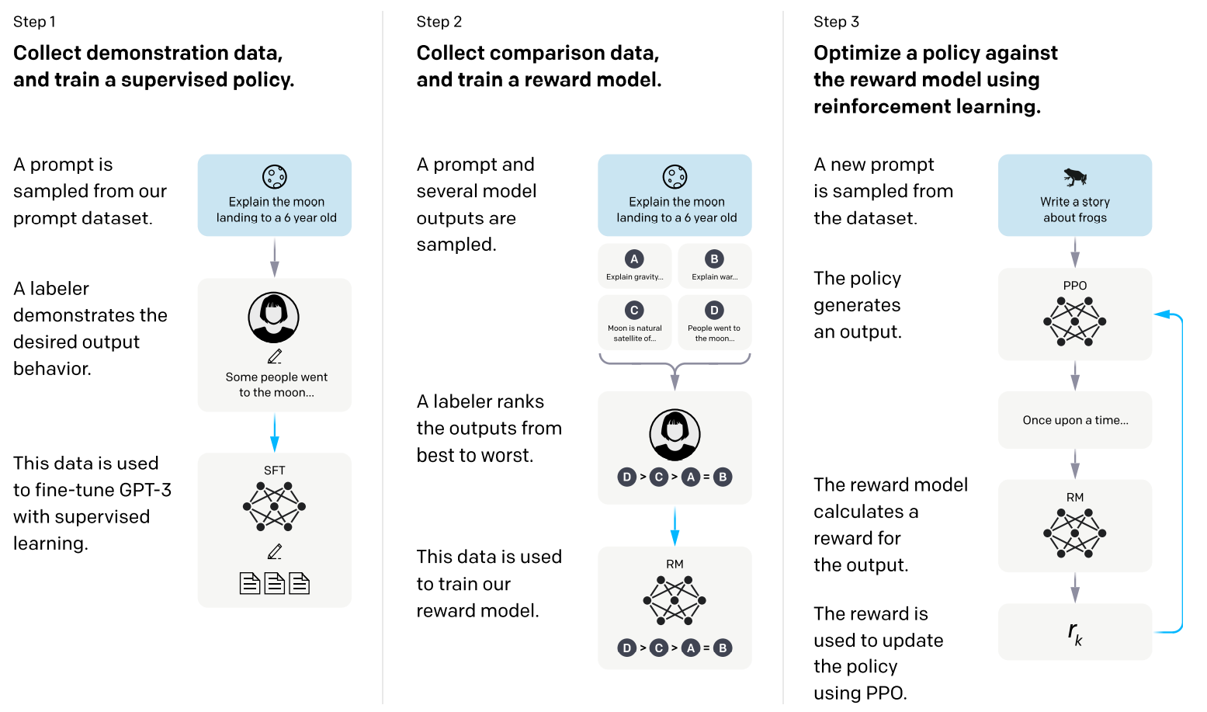
Pre-Trained Language Models
Proximal Policy Optimization
Supervised
Fine-Turning (SFT)

Slide 40
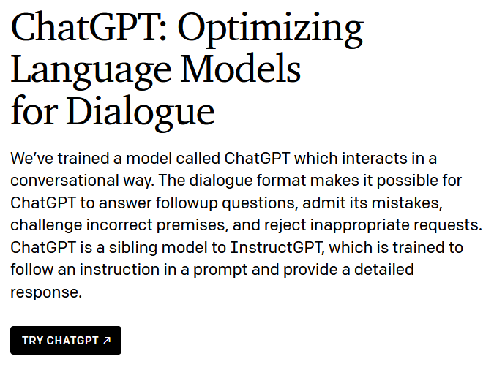
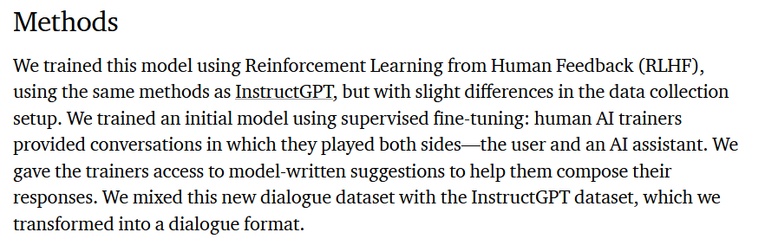
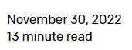
Pre-Trained Language Models
ChatGPT
Notes:
https://openai.com/blog/chatgpt/
We trained this model using Reinforcement Learning from Human Feedback (RLHF), using the same methods as InstructGPT, but with slight differences in the data collection setup. We trained an initial model using supervised fine-tuning: human AI trainers provided conversations in which they played both sides—the user and an AI assistant. We gave the trainers access to model-written suggestions to help them compose their responses. We mixed this new dialogue dataset with the InstructGPT dataset, which we transformed into a dialogue format.

Slide 41
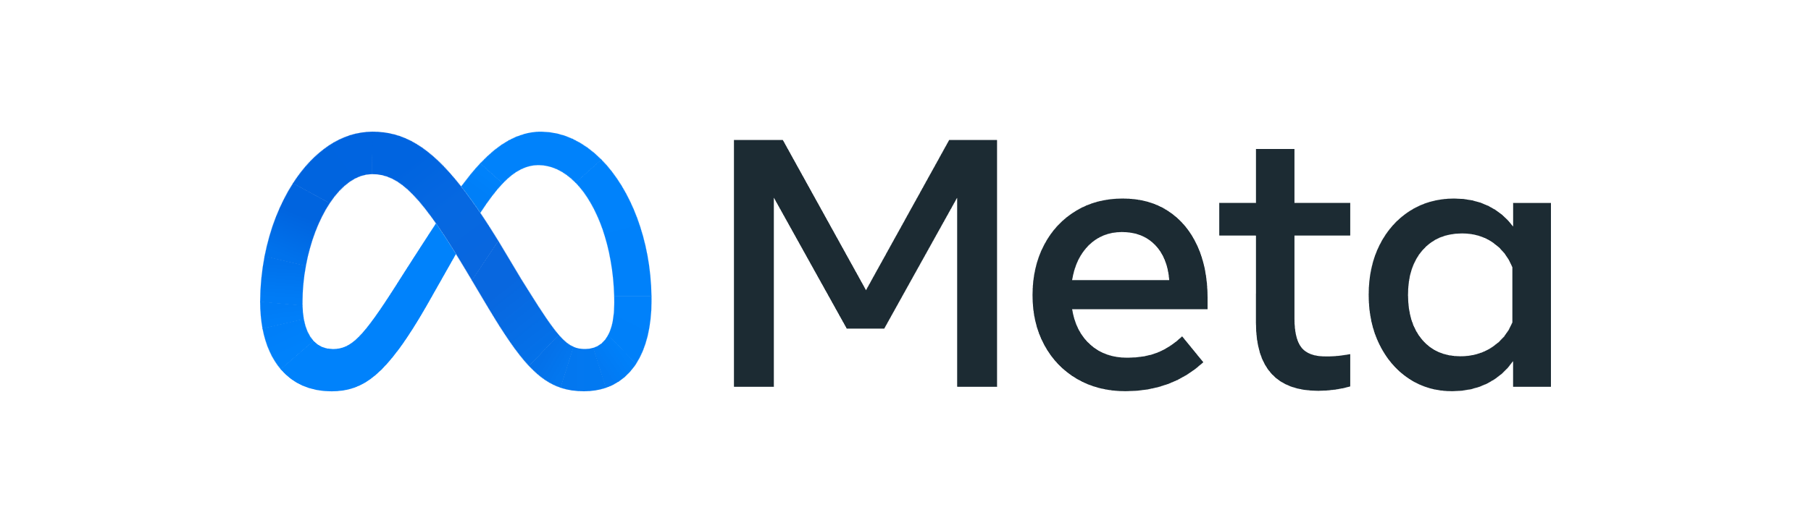
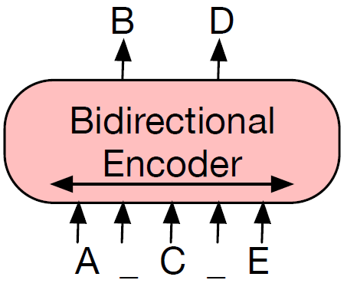
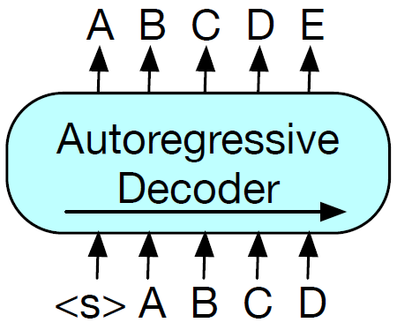
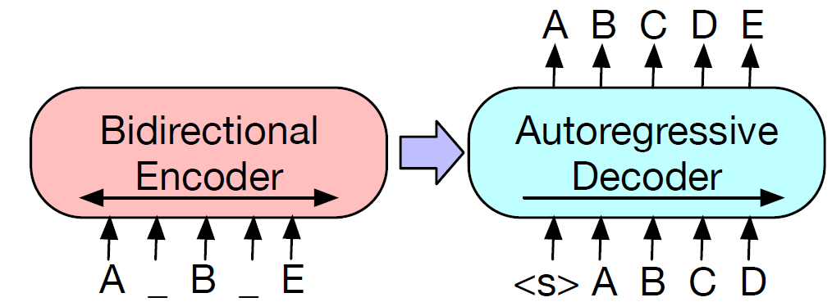
Pre-Trained Language Models
BART: Pre-Trained Sequence-to-Sequence Language Models
(a) BERT: Random tokens are replaced with masks, and the document is encoded bidirectionally. Missing tokens are predicted independently, so BERT cannot easily be used for generation.
(b) GPT: Tokens are predicted auto-regressively, meaning GPT can be used for generation. However words can only condition on leftward context, so it cannot learn bidirectional interactions.
(c) BART: Inputs to the encoder need not be aligned with decoder outputs, allowing arbitrary noise transformations. Here, a document has been corrupted by replacing spans of text with a mask symbols. The corrupted document (left) is encoded with a bidirectional model, and then the likelihood of the original document (right) is calculated with an autoregressive decoder.
Notes:
BART pre-trains a model combining Bidirectional and Auto-Regressive Transformers.

Slide 42
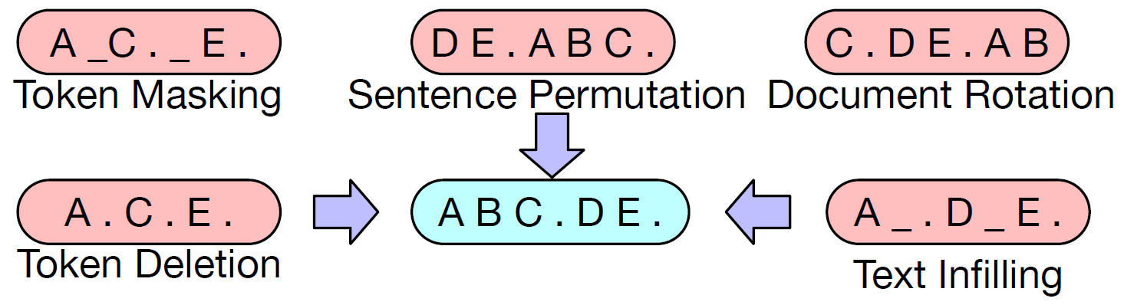
Pre-Trained Language Models
BART: Pre-Trained Sequence-to-Sequence Language Models
Pre-Training
A document is divided into sentences based on full stops, and these sentences are shuffled in a random order.
A token is chosen uniformly at random, and the document is rotated so that it begins with that token. This task trains the model to identify the start of the document.
Random tokens are sampled and replaced with [MASK] elements.
Random tokens are deleted from the input.
A number of text spans are sampled, with span lengths drawn from a Poisson distribution. Each span is replaced with a single [MASK] token.
BART is a denoising autoencoder for pretraining sequence-to-sequence models. It is trained by corrupting documents and then optimizing a reconstruction loss, i.e., the cross-entropy between the decoder’s output and the original document.
Notes:
https://www.google.com/url?sa=t&source=web&rct=j&opi=89978449&url=https://aclanthology.org/2020.acl-main.703.pdf&ved=2ahUKEwiFoM69jqeKAxVumq8BHa8zKwYQFnoECBYQAQ&usg=AOvVaw2xDJqw8spfIplqRPBqTZkJ
BART pre-trains a model combining Bidirectional and Auto-Regressive Transformers.

Slide 43
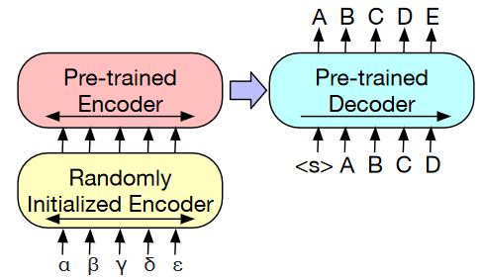
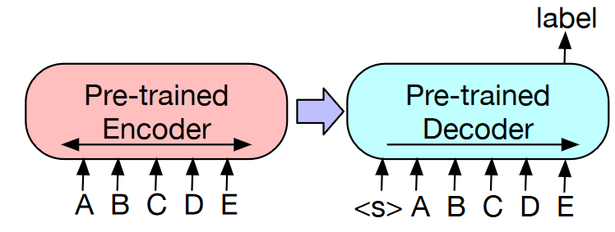
Pre-Trained Language Models
BART: Pre-Trained Sequence-to-Sequence Language Models
Fine-Tuning
(a) To use BART for classification problems, the same input is fed into the encoder and decoder, and the representation from the final output is used.
(b) For machine translation, it learns a small additional encoder that replaces the word embeddings in BART. The new encoder can use a disjoint vocabulary.
Fine-Tuning BART for Classification and Translation

Slide 44

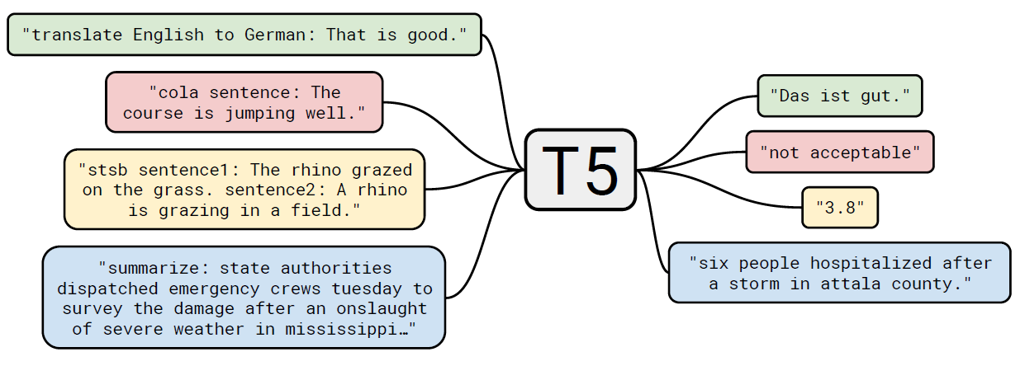
Pre-Trained Language Models
T5: Text-to-Text Transfer Transformer
Transformer Encoder-Decoder
task-Specific Prefix
A Shared Text-To-Text Framework
Notes:
Single framework for multiple tasks: https://jmlr.org/papers/volume21/20-074/20-074.pdf
Multi-Task Learning
The T5 model, pre-trained on C4, achieves state-of-the-art results on many NLP benchmarks while being flexible enough to be fine-tuned to a variety of important downstream tasks.
Diagram of our text-to-text framework. Every task we consider uses text as input to the model, which is trained to generate some target text. This allows us to use the same model, loss function, and hyperparameters across our diverse set of tasks including translation (green), linguistic acceptability (red), sentence similarity (yellow), and document summarization (blue). It also provides a standard testbed for the methods included in our empirical survey.
Overall, our encoder-decoder Transformer implementation closely follows its originally proposed form.
To specify which task the model should perform, we add a task-specific (text) prefix to the original input sequence before feeding it to the model.
Sentence acceptability judgment (CoLA)
Sentence similarity (STS-B)

Slide 45

Pre-Trained Language Models
T5: Text-to-Text Transfer Transformer
Notes:
Extensions
T5 is flexible enough to be easily modified for application to many tasks beyond those considered in our paper, often with great success. Below, we apply T5 to two novel tasks: closed-book question answering and fill-in-the-blank text generation with variable-sized blanks.
Closed-Book Question Answering
One way to use the text-to-text framework is on reading comprehension problems, where the model is fed some context along with a question and is trained to find the question's answer from the context. For example, one might feed the model the text from the Wikipedia article about Hurricane Connie along with the question "On what date did Hurricane Connie occur?" The model would then be trained to find the date "August 3rd, 1955" in the article. In fact, we achieved state-of-the-art results on the Stanford Question Answering Dataset (SQuAD) with this approach.
In our Colab demo and follow-up paper, we trained T5 to answer trivia questions in a more difficult "closed-book" setting, without access to any external knowledge. In other words, in order to answer a question T5 can only use knowledge stored in its parameters that it picked up during unsupervised pre-training. This can be considered a constrained form of open-domain question answering.

Slide 46





Large Language Models
Masked Language Model
Encoder
-Only
Encoder-
Decoder
Decoder-Only
GPT
Transformers have epoch-making significance for the development of NLP.
Auto-Regressive Language Model
Notes:
Pre-trained models for natural language processing: a survey, by Xipeng Qiu
Must-Read Papers on Pre-trained Language Models (PLMs) (for research students)
https://github.com/thunlp/PLMpapers
BERT: Pre-training of Deep Bidirectional Transformers for Language Understanding
https://arxiv.org/abs/1810.04805
進擊的 BERT：NLP 界的巨人之力與遷移學習
https://leemeng.tw/attack_on_bert_transfer_learning_in_nlp.html

Slide 47

Notes:
https://arxiv.org/abs/2304.13712， Harnessing the Power of LLMs in Practice: A Survey on ChatGPT and Beyond
主要玩家有：Google, OpenAI， Facebook/Meta

Slide 48



Large Language Models
From Pre-Training/Fine-Tuning to Pre-Training/Prompting
Fine-Tuning
Prompting
Source: https://blog.research.google/2022/02/guiding-frozen-language-models-with.html
Notes:
Training large pretrained language models is very time-consuming and compute-intensive. As they continue to grow in size, there is increasing interest in more efficient training methods such as prompting. Prompting primes a frozen pretrained model for a specific downstream task by including a text prompt that describes the task or even demonstrates an example of the task. With prompting, you can avoid fully training a separate model for each downstream task, and use the same frozen pretrained model instead. This is a lot easier because you can use the same model for several different tasks, and it is significantly more efficient to train and store a smaller set of prompt parameters than to train all the model’s parameters.
PromptPapers
https://github.com/thunlp/PromptPapers
Prompt Blogs:
https://blog.research.google/2022/02/guiding-frozen-language-models-with.html
https://blog.csdn.net/BAAIBeijing/article/details/121005830
https://thegradient.pub/prompting/
Prompt Videos:
https://www.youtube.com/watch?v=nnylYEh4bpI
https://www.youtube.com/watch?v=K3MasIU25Zw
https://www.youtube.com/watch?v=OsbUfL8w-mo
https://www.youtube.com/watch?v=TE6urdkTR4I&t=2304s [CMU Advanced NLP 2021 (10): Prompting + Sequence-to-sequence Pre-training]

Slide 49



?
Notes:
Pre-train, Prompt, and Predict: A Systematic Survey of Prompting Methods in Natural Language Processing, ACM Computing Survey, 2022.
Prompt Engineering: Prompt Functions
PromptPapers
https://github.com/thunlp/PromptPapers
Prompt Blogs:
https://blog.csdn.net/BAAIBeijing/article/details/121005830
https://thegradient.pub/prompting/
https://blog.paperspace.com/prompt-based-learning-in-natural-language-processing/

Slide 50

Large Language Models
Chain-of-Thought (Few-Shot) Prompting
Few-Shot Prompting
Chain-of-Thought prompting elicits reasoning in large language models.
Notes:
Chain-of-Thought Prompting Blog
Chain-of-Thought Promoting at Prompt Engineering Guide: https://www.promptingguide.ai/techniques/cot
预训练模型不具备逻辑推理的能力。
基于神经网络的知识推理研究综述 http://fcst.ceaj.org/CN/10.3778/j.issn.1673-9418.2108105
思维链
我们探索如何生成一个思维链，一系列中间推理步骤，如何显着提高大型语言模型执行复杂推理的能力。 特别是，我们展示了这种推理能力如何通过一种称为思维链提示的简单方法自然地出现在足够大的语言模型中，其中提供了一些思维链演示作为提示中的示例。对三种大型语言模型的实验表明，思维链提示可以提高一系列算术、常识和符号推理任务的性能。
Chain-of-Thought Prompting Elicits Reasoning in Large Language Models

Slide 51

Large Language Models
Chain-of-Thought (Zero-Shot) Prompting
Zero-Shot CoT essentially involves adding “Let's think step by step” to the original prompt. This is particularly useful where you don't have too many examples to use in the prompt.
Zero-Shot Prompting

Slide 52

Large Language Models
Chain-of-Thought (Zero-Shot) Prompting
Reasoning Prompt
Answer Prompt
Two-Stage Prompting
Notes:
Paper:
Full pipeline of Zero-shot-CoT: we first use the first “reasoning” prompt to extract a full reasoning path from a language model, and then use the second “answer” prompt to extract the answer in the correct format from the reasoning text.

Slide 53

Large Language Models
CoT with Self-Consistency
The idea is to sample multiple, diverse reasoning paths through few-shot CoT, and use the generations to select the most consistent answer. This helps to boost the
performance of CoT prompting on tasks involving arithmetic and commonsense reasoning.
Notes:
Perhaps one of the more advanced techniques out there for prompt engineering is self-consistency.

Slide 54



Large Language Models
Refinement/Correction with Feedback
Self-Evaluate (T/F and MC)
？
Evaluate using
External Tools
LLM
Refine
Prompt
Feedback
Inference
Notes:
We study whether language models can evaluate the validity of their own claims and predict which questions they will be able to answer correctly. We first show that larger models are well-calibrated on diverse multiple choice and true/false questions when they are provided in the right format. Thus we can approach self-evaluation on open-ended sampling tasks by asking models to first propose answers, and then to evaluate the probability "P(True)“ that their answers are correct. We find encouraging performance, calibration, and scaling for P(True) on a diverse array of tasks.

Slide 55


Large Language Models
Refinement with Self-Feedback
Self-Refine allows LLMs to iteratively refine outputs and incorporate feedback to improve performance on diverse tasks.
Few-Shot Prompting
Notes:
https://selfrefine.info/
Self-Refine is a novel approach that allows LLMs to iteratively refine outputs and incorporate feedback along multiple dimensions to improve performance on diverse tasks. Unlike prior work, it does not require supervised training data or reinforcement learning, and works with a single LLM.
Self-Refine: Iterative Refinement with Self-Feedback
We implemented both FEEDBACK and REFINE as few-shot prompts even with models that respond well to instructions, such as ChatGPT and GPT-4.

Slide 56

Large Language Models
From Reinforcement Learning from Human Feedback (RLHF) to Reinforcement Learning from AI Feedback (RLAIF)
Automating RLHF with AI Feedback
LLM
Evaluate and Feedback
Prompt
Update
Training
As AI systems become more capable, we would like to enlist their help to supervise other AIs.

Slide 57

Large Language Models
From Reinforcement Learning from Human Feedback (RLHF) to Reinforcement Learning from AI Feedback (RLAIF)
RM: Reward Model
Notes:
Reward Model (RM)

Slide 58

Large Language Models

Slide 59

Large Language Models
Self-Improvement/Self-Evolution of Large Language Models

Slide 60








References
YouTube Videos
Notes:
GPT-2 Tutorial: https://www.youtube.com/watch?v=Ppf4ApbumcA
GPT-1 Tutorial: https://www.youtube.com/watch?v=pm8kSceBmNw

Slide 61
References
Book Chapters
Speech and Language Processing
Chapter 10: Large Language Models
Chapter 11: Masked Language Models
Chapter 12: Model Alignment, Prompting, and In-Context Learning
Notes:
Pre-trained models for natural language processing: a survey, by Xipeng Qiu
Must-Read Papers on Pre-trained Language Models (PLMs) (for research students)
https://github.com/thunlp/PLMpapers
Pre-trained Language Model
https://leemeng.tw/attack_on_bert_transfer_learning_in_nlp.html
https://arxiv.org/abs/1810.04805

Slide 62
References
Reference Papers
BERT: Pre-training of Deep Bidirectional Transformers for Language Understanding, NAACL-HLT’2019. (BERT)
Improving Language Understanding by Generative Pre-Training, 2018. (GPT)
Language Models are Unsupervised Multitask Learners, 2020. (GPT-2)
Language Models are Few-Shot Learners, arXiv’2020. (GPT-3)
Training Language Models to Follow Instructions with Human Feedback, arXiv’2022. (InstructGPT)
Notes:
Pre-trained models for natural language processing: a survey, by Xipeng Qiu
Must-Read Papers on Pre-trained Language Models (PLMs) (for research students)
https://github.com/thunlp/PLMpapers
Pre-trained Language Model
https://leemeng.tw/attack_on_bert_transfer_learning_in_nlp.html
https://arxiv.org/abs/1810.04805

Slide 63
References
Reference Papers
BART: Denoising Sequence-to-Sequence Pre-training for Natural Language Generation, Translation, and Comprehension, ACL’2020. (BART)
Chain-of-Thought Prompting Elicits Reasoning in Large Language Models, NeurIPS’2022. (CoT)
Large Language Models are Zero-Shot Reasoners, NeurIPS’2022. (Zero-Shot CoT)
Notes:
Pre-trained models for natural language processing: a survey, by Xipeng Qiu
Must-Read Papers on Pre-trained Language Models (PLMs) (for research students)
https://github.com/thunlp/PLMpapers
Pre-trained Language Model
https://leemeng.tw/attack_on_bert_transfer_learning_in_nlp.html
https://arxiv.org/abs/1810.04805

Slide 64
References
Pre-Trained Language Model Surveys
Recent Advances in Natural Language Processing via Large Pre-Trained Language Models: A Survey, arXiv’2021.
Pre-trained Models for Natural Language Processing: A Survey, arXiv’2021.
Pre-train, Prompt, and Predict: A Systematic Survey of Prompting Methods in Natural Language Processing, ACM Computing Survey, 2022.
Notes:
Pre-trained models for natural language processing: a survey, by Xipeng Qiu
Must-Read Papers on Pre-trained Language Models (PLMs) (for research students)
https://github.com/thunlp/PLMpapers
Pre-trained Language Model
https://leemeng.tw/attack_on_bert_transfer_learning_in_nlp.html
https://arxiv.org/abs/1810.04805

Slide 65


Slide 66

Pre-Trained Language Models
Pre-Training and Fine-Tuning Paradigm
Self-supervised Pre-training
Supervised Fine-Turning
Notes:
Chapter 11, P11:
The power of pre-trained language models lies in their ability to extract generalizations from large amounts of text—generalizations that are useful for myriad downstream applications. To make practical use of these generalizations, we need to create interfaces from these models to downstream applications through a process called fine-tuning. Fine-tuning facilitates the creation of applications on top of pretrained models through the addition of a small set of application-specific parameters.

Slide 67
Large Language Models
Frequently Used Terms for Large Language Models
Pre-Training and Fine-Tuning
In Context Learning (ICL)
Prompting
Instruction Tuning (Instruction Finetuning, Supervised Finetuning)
(Instruction, Value, Safety, Fairness, Privacy, etc.) Alignment

